Slide 1

Bacchus Winery
Group 3

Slide 2
Group 3 Members
Truman Forey
Arely Gil
Elizabeth Hinz
Lea Trueworthy
Megan Wheeler

Slide 3
Case Study Overview
Bacchus Winery, a family-owned business, is transitioning leadership from George Bacchus to his children, Stan and Davis Bacchus. They aim to improve their operations with a focus on inventory management, distribution tracking, supplier performance, and employee hours. Key challenges identified by the winery include:
Managing supplier deliveries
Tracking wine distribution
Monitoring employee time and productivity
Improving communication and data visibility
The winery has four main types of wine in production: Merlot, Cabernet, Chablis, and Chardonnay. It currently uses manual processes for tracking supplies, employee hours, and distribution. The new system aims to modernize these processes and help Bacchus Winery run more efficiently.

Slide 4

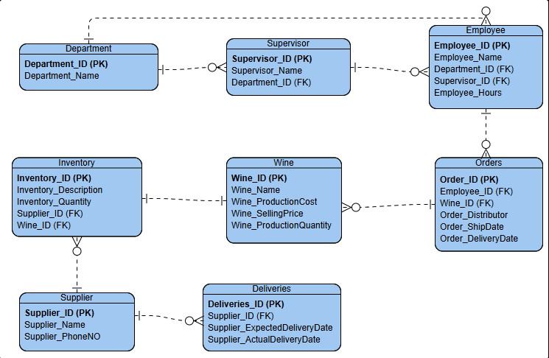
ERD

Slide 5
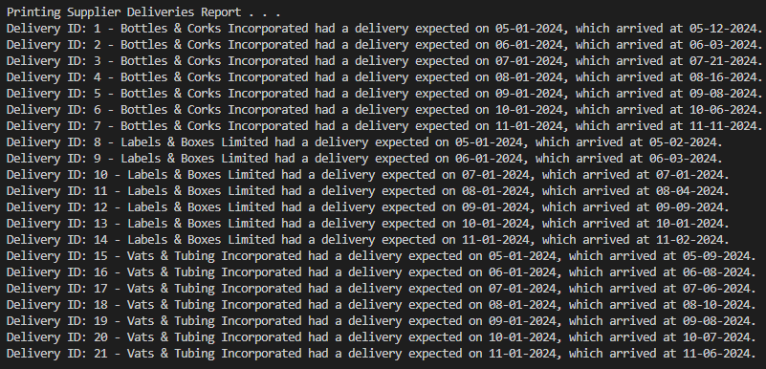
Supplier Delivery Report
Purpose: To check whether all suppliers are delivering on time, and to identify any delays in supply deliveries.

Slide 6

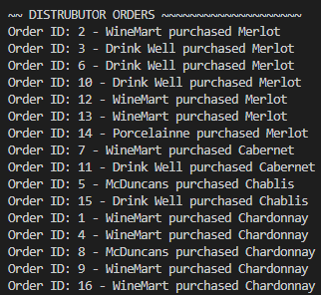
Wine Sales Distribution Report
Purpose: To analyze which wines are performing well and identify any low-performing wines.

Slide 7
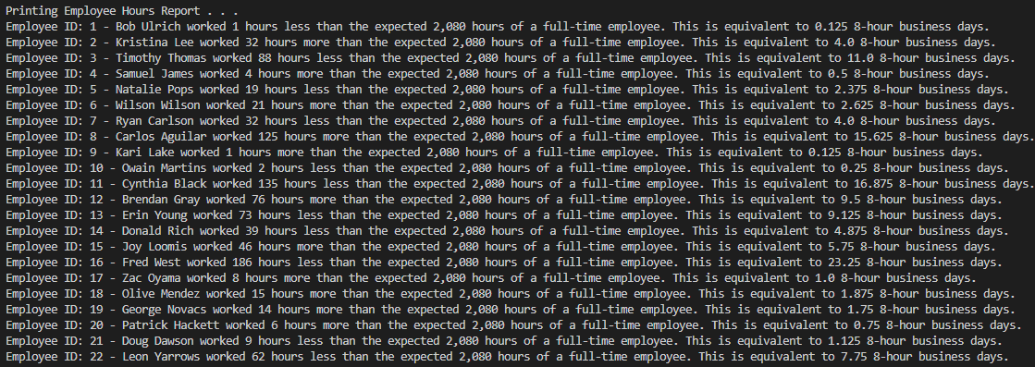
Employee Work Hours Report
Purpose: To track the number of hours worked by each employee in the past year.

Slide 8
Case Study problems & solutions
Are suppliers meeting their delivery deadlines, or is there a significant discrepancy between expected and actual delivery times?
Solution: If a supplier has 3 or more late deliveries exceeding a week (out of 6), we will cease doing business with them.
Are all wines selling as expected? Is any wine underperforming? Which distributor handles each wine?
Solution: Adjust wine production based on demand: reduce production if orders are less than production and increase it if orders exceed production.
How many hours did each employee work over the past four quarters?
Solution: Employees missing over 5 but fewer than 10 business days will receive a warning. Those missing 10 or more business days will be terminated.

Slide 9
Assumptions
Each employee works for only one department.
Each wine is produced from grapes grown by the winery.
Each order is for a single wine type.
Inventory items are not shared across different wines.

Slide 10
Design Decisions
Modular Functions: Each report is encapsulated in its own function for readability, maintainability, and reusability.
Simple UI: A loop with a menu allows users to select reports or quit, offering flexibility and easy navigation.
Clear Output: Uses formatted strings for easy-to-read report outputs.
Error Handling: Handles invalid inputs to prevent errors and ensure smooth user experience.
Test Function Placeholder: Includes a test_reports function for potential future testing or debugging.

Slide 11
Conclusion
This system design will help Bacchus Winery improve its operations in key areas such as supplier delivery management, wine distribution tracking, and employee time management. The proposed reports provide visibility and actionable insights that will help the winery make informed decisions, optimize processes, and improve overall business efficiency.

